Slide 1

Programming Your GPU with OpenMP*
Tim Mattson
Intel Corp.
timothy.g.mattson@ intel.com
Simon McIntosh-Smith
University of Bristol
simonm@cs.bris.ac.uk
Eric Stotzer
Texas Instruments
estotzer@ti.com
… and the McIntosh-Smith group at the University of Bristol: Tom Deakin, Matt Martineau and James Price
Tutorial materials are available here: https://github.com/uob-hpc/openmp-tutorial

Slide 2
Preliminaries: Part 1
Disclosures
The views expressed in this tutorial are those of the people delivering the tutorial.
We are not speaking for our employers.
We are not speaking for the OpenMP ARB
We take these tutorials VERY seriously:
Help us improve … tell us how you would make this tutorial better.

Slide 3
Preliminaries: Part 2
Our plan for the day .. Active learning!
We will mix short lectures with short exercises.
You will use your laptop to connect to a multiprocessor server.
Please follow these simple rules
Do the exercises that we assign and then change things around and experiment.
Embrace active learning!
Don’t cheat: Do Not look at the solutions before you complete an exercise … even if you get really frustrated.

Slide 4

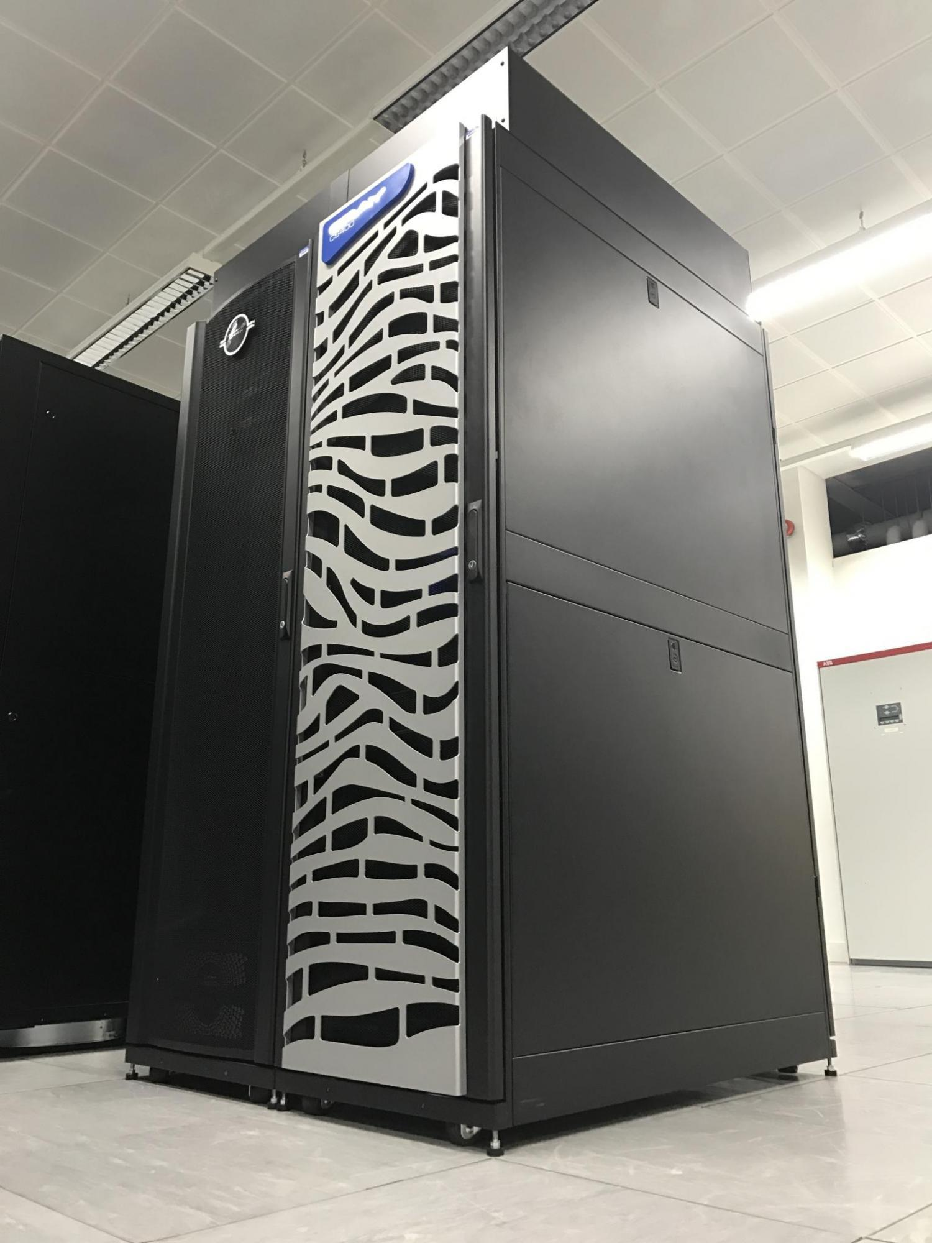




Collaboration between GW4 Alliance (universities of Bristol, Bath, Cardiff, Exeter), the UK Met Office, Cray, and Arm
~£3 million, funded by EPSRC
Expected to be the first large-scale, Arm-based production supercomputer
10,000+ Armv8 cores
Also contains some Intel Xeon Phi (KNL), Intel Xeon (Broadwell), and NVIDIA P100 GPUs
Cray compilers provide the OpenMP implementation for GPU offloading

Slide 5
Plan
Module | Concepts | Exercises
OpenMP overview | OpenMP recap Hardcore jargon of OpenMP | None … we’ll use demo mode so we can move fast
The device model in OpenMP | Intro to the Target directive with default data movement | pi program
Understanding execution | Intro to nvprof | nvprof ./pi
Basic memory movement | The map clause | Jacobi solver
Working with the target directive | CPU and GPU execution models and the fundamental combined directive | Pi with combined directive using nvprof to understand execution
Optimizing memory movement | Target data regions | Jacobi with explicit data movement
Optimizing GPU code | Common GPU optimizations | Optimized Jacobi solver
Stencil | Practice everything you’ve learned! | 5-point stencil

Slide 6
Agenda … speaker plan
Starting the tutorial
OpenMP overview
The device model in OpenMP
Understanding execution on the GPU with nvprof
Moving memory to/from the device
Working with the target directive
Controlling memory movement
Optimizing GPU code
CPU/GPU portability
5-point stencil
OpenMP 5.0
Closing
Tim
Tim
Tim
Tom for Isambard content
Tom
Tim
Eric
Eric
Simon
Simon
Tom
Eric
Tim

Slide 7
Agenda
OpenMP overview
The device model in OpenMP
Understanding execution on the GPU with nvprof
Moving memory to/from the device
Working with the target directive
Controlling memory movement
Optimizing GPU code
CPU/GPU portability
5-point stencil
OpenMP 5.0

Slide 8
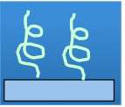
OpenMP basic definitions: Basic Solution stack
End User
User layer
Application
Prog. Layer
Directives,
Compiler
OpenMP library
Environment variables
OpenMP Runtime library
System layer
OS/system support for shared memory and threading
. . .
HW
Shared address space (SMP)
When we launched OpenMP, our focus was on Symmetric Multiprocessor Case …. i.e. lots of threads with “equal cost access” to memory

Slide 9
OpenMP programming model:
Fork-Join Parallelism:
Master thread spawns a team of threads as needed.
Parallelism added incrementally until performance goals are met, i.e., the sequential program evolves into a parallel program.
Parallel Regions
A Nested Parallel region
Master Thread in red
Sequential Parts

Slide 10
The growth of complexity in OpenMP
OpenMP started out in 1997 as a simple interface for the application programmers more versed in their area of science than computer science.
The complexity has grown considerably over the years!
Page counts (not counting front matter, appendices or index) for versions of OpenMP
Fortran spec
5.0
C/C++ spec
Merged C/C++ and Fortran spec
OpenMP Spec plus the tools/debug API
Page counts (spec only)
4.5
4.0
3.0
3.1
2.5
1.0
1.0
1.1
2.0
2.0
year

Slide 11
The growth of complexity in OpenMP
OpenMP started out in 1997 as a simple interface for the application programmers more versed in their area of science than computer science.
The complexity has grown considerably over the years!
Page counts (not counting front matter, appendices or index) for versions of OpenMP
Fortran spec
5.0
C/C++ spec
Merged C/C++ and Fortran spec
Supports general multithreading, but the emphasis was on parallel loops
OpenMP Spec plus the tools/debug API
Page counts (spec only)
4.5
4.0
3.0
3.1
2.5
1.0
1.0
1.1
2.0
2.0
year

Slide 12
Numerical integration: the pi program
Mathematically, we know that:
1
4.0
∫
4.0
dx = π
(1+x²)
0
We can approximate the integral as a sum of rectangles:
2.0
F(x) = 4.0/(1+x²)
N
∑ F(x_{i})Δx ≈ π
i = 0
Where each rectangle has width Δx and height F(x_{i}) at the middle of interval i.
0.0
X
1.0

Slide 13
Serial PI program
static long num_steps = 100000;
double step;
int main ()
{ int i; double x, pi, sum = 0.0;
step = 1.0/(double) num_steps;
for (i=0; i< num_steps; i++){
x = (i+0.5)*step;
sum = sum + 4.0/(1.0+x*x);
}
pi = step * sum;
}
See sc18-tutorial/pi.c

Slide 14
Example: Pi with a loop and a reduction
#include <omp.h>
static long num_steps = 100000; double step;
void main ()
{ int i; double x, pi, sum = 0.0;
step = 1.0/(double) num_steps;
#pragma omp parallel
{
double x;
#pragma omp for reduction(+:sum)
for (i=0; i< num_steps; i++){
x = (i+0.5)*step;
sum = sum + 4.0/(1.0+x*x);
}
}
pi = step * sum;
}
Create a team of threads … without a parallel construct, you’ll never have more than one thread
Create a scalar local to each thread to hold value of x at the center of each interval
Break up loop iterations and assign them to threads … setting up a reduction into sum. Note … the loop index is local to a thread by default.

Slide 15
The growth of complexity in OpenMP
OpenMP started out in 1997 as a simple interface for the application programmers more versed in their area of science than computer science.
The complexity has grown considerably over the years!
Page counts (not counting front matter, appendices or index) for versions of OpenMP
Fortran spec
5.0
C/C++ spec
Merged C/C++ and Fortran spec
OpenMP Spec plus the tools/debug API
Page counts (spec only)
Tasks added to OpenMP ... supports irregular parallelism
4.5
4.0
3.0
3.1
2.5
1.0
1.0
1.1
2.0
2.0
year
Notes:
OpenMP 3.0 was released in May of 2008

Slide 16
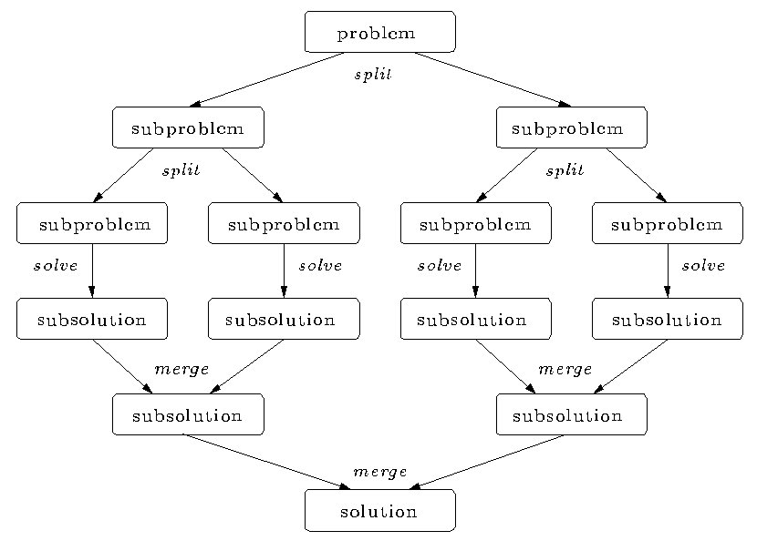
Divide and conquer
Split the problem into smaller sub-problems; continue until the sub-problems can be solved directly
3 Options:
Do work as you split into sub-problems
Do work only at the leaves
Do work as you recombine

Slide 17
Program: Divide and conquer pi program
#include <omp.h>
static long num_steps = 100000000;
#define MIN_BLK 10000000
double pi_comp(int Nstart,int Nfinish,double step)
{ int i,iblk;
double x, sum = 0.0,sum1, sum2;
if (Nfinish-Nstart < MIN_BLK){
for (i=Nstart;i< Nfinish; i++){
x = (i+0.5)*step;
sum = sum + 4.0/(1.0+x*x); } }
else{
iblk = Nfinish-Nstart;
sum1 = pi_comp(Nstart, Nfinish-iblk/2,step);
sum2 = pi_comp(Nfinish-iblk/2, Nfinish, step);
sum = sum1 + sum2;
}
return sum;
}
int main ()
{
int i;
double step, pi, sum;
step = 1.0/(double) num_steps;
sum = pi_comp(0,num_steps,step);
pi = step * sum;
}
solve
split

Slide 18
Program: OpenMP tasks
#include <omp.h>
static long num_steps = 100000000;
#define MIN_BLK 10000000
double pi_comp(int Nstart,int Nfinish,double step)
{ int i,iblk;
double x, sum = 0.0,sum1, sum2;
if (Nfinish-Nstart < MIN_BLK){
for (i=Nstart;i< Nfinish; i++){
x = (i+0.5)*step;
sum = sum + 4.0/(1.0+x*x); } }
else{
iblk = Nfinish-Nstart;
#pragma omp task shared(sum1)
sum1 = pi_comp(Nstart, Nfinish-iblk/2,step);
#pragma omp task shared(sum2)
sum2 = pi_comp(Nfinish-iblk/2, Nfinish, step);
#pragma omp taskwait
sum = sum1 + sum2;
}return sum;
}
int main ()
{
int i;
double step, pi, sum;
step = 1.0/(double) num_steps;
#pragma omp parallel
{
#pragma omp single
sum = pi_comp(0,num_steps,step);
}
pi = step * sum;
}

Slide 19
Adding tasks to OpenMP required major changes to the specification
Fork-Join Parallelism:
Master thread spawns a team of threads as needed.
Parallelism added incrementally until performance goals are met, i.e., the sequential program evolves into a parallel program.
Parallel Regions
Master Thread in red
Sequential Parts

Slide 20
Adding tasks to OpenMP required major changes to the specification
Fork-Join Parallelism:
Master thread spawns a team of threads as needed.
Parallelism added incrementally until performance goals are met, i.e., the sequential program evolves into a parallel program.
Master Thread in red
Let’s focus on just one fork/join

Slide 21
Low Level details of OpenMP
Program begins. Launches Initial thread.
Threads wait at barrier
Implicit parallel region surrounds entire program
Barrier satisfied
Implicit tasks terminate
Initial task begins execution
Initial thread encounters the parallel construct.
Initial task continues
Initial task creates a team of threads
Each thread in the team runs the implicit task defined by the parallel region
Initial task is suspended

Slide 22
Why all this complexity around tasks?
Remember: a language specification is written for people who implement the language … they have ZERO tolerance for ANY ambiguity.
By defining a thread as an execution entity that runs tasks, we can define semantics in terms of tasks and consistently apply it everywhere.
While all these initial threads, implicit tasks, and such are confusing to the programmer, they actually make life easier for people who implement OpenMP.

Slide 23
The growth of complexity in OpenMP
OpenMP started out in 1997 as a simple interface for the application programmers more versed in their area of science than computer science.
The complexity has grown considerably over the years!
Page counts (not counting front matter, appendices or index) for versions of OpenMP
Target constructs added to OpenMP ... supports host-device model
Fortran spec
5.0
C/C++ spec
Merged C/C++ and Fortran spec
OpenMP Spec plus the tools/debug API
Page counts (spec only)
Tasks added to OpenMP ... supports irregular parallelism
4.5
4.0
3.0
3.1
2.5
1.0
1.0
1.1
2.0
2.0
year
Notes:
OpenMP 4.0 released July 2013

Slide 24
OpenMP basic definitions: Basic Solution stack
End User
User layer
Application
Prog. Layer
Directives,
Compiler
OpenMP library
Environment variables
OpenMP Runtime library
System layer
OS/system support for shared memory and threading
HW
Shared address space (NUMA)
CPU cores
SIMD units
GPU cores

Slide 25
Agenda
OpenMP overview
The device model in OpenMP
Understanding execution on the GPU with nvprof
Moving memory to/from the device
Working with the target directive
Controlling memory movement
Optimizing GPU code
CPU/GPU portability
5-point stencil
OpenMP 5.0

Slide 26
The OpenMP device programming model
OpenMP uses a host/device model
The host is where the initial thread of the program begins execution
Zero or more devices are connected to the host
Device-memory address space is distinct from host-memory address space
…
…
#include <omp.h>
#include <stdio.h>
int main()
{
printf(“There are %d devices\n”,
omp_get_num_devices());
}
…
…
…
…
…
…
…
Host
…
…
…
…
…
…
Device

Slide 27
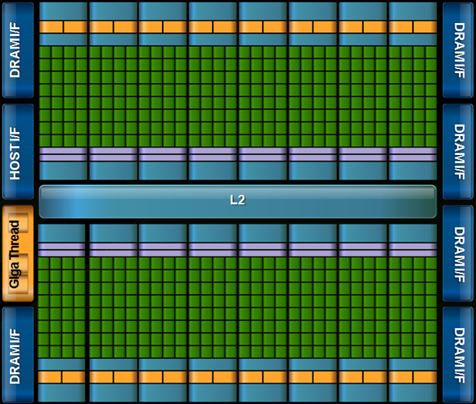
OpenMP with target devices
The target construct offloads execution to a device.
#pragma omp target
{….} // a structured block of code
Program begins. Launches Initial thread running on the host device.
Initial task on host continues once execution associated with the target region completes
Implicit parallel region surrounds entire program
Initial task begins execution
Initial thread encounters the target directive.
Initial task generates a target task which is a mergable, included task
A new initial thread runs on the device.
Target task launches target region on the device
Implicit parallel region surrounds device program
Initial task executes code in the target region.

Slide 28
The target data environment
Remember: distinct memory spaces on host and device.
OpenMP uses a combination of implicit and explicit memory movement.
Data may move between the host and the device in well defined places:
Firstly, at the beginning and end of a target region: #pragma omp target { // Data may move here … } // and here
We’ll discuss the other places later…

Slide 29
Default Data Mapping: implicit movement on a target region
Scalar variables:
Examples:
int N; double x;
OpenMP 4.5 implicitly maps scalar variables as firstprivate
A new value per thread and initialized with the original value.
The variable is not copied back to the host at the end of the target region.
OpenMP target regions for GPUs execute with CUDA/OpenMP, and a firstprivate scalar can be launched as a parameter to a kernel function without the overhead of setting up a variable in device memory.

Slide 30
Default Data Mapping: implicit movement on a target region
Non-scalar variables:
Must have a complete type.
Example: fixed sized (stack) array:
double A[1000];
Copied to the device at the start of the target region, and copied back at the end.
A new value is created in the target region and initialized with the original data, but it is shared between threads on the device. Data is copied back to the host at the end of the target region.
OpenMP calls this mapping tofrom

Slide 31
Default Data Mapping: implicit movement on a target region
Pointers and their data:
Example: arrays allocated on the heap
double *A = malloc(sizeof(double)*1000);
The pointer value will be mapped.
But the data it points to will not be mapped by default.
In C, OpenMP defines that the pointer is mapped as a zero-length array section.
Array section notation: ptr[lower bound : length]
Zero length arrays: A[:0]
We’ll show you how to map a pointer’s data very shortly.

Slide 32
The target data environment
Scalars and statically allocated arrays are moved onto the device by default before execution
Host thread
Generating Task
float A[N], B[N];
A, B and N mapped to the device
#pragma omp target
Initial task
Host thread
waits for the task region to complete
{
target region, can use A, B and N
}
Target task
Device Initial thread
the arrays A and B mapped back to the host
Only the statically allocated arrays are moved back to the host after the target region completes
Based on figure 6.4 in Using OpenMP – The Next Step by van der Pas, Stotzer and Terboven, MIT Press, 2017

Slide 33
Default Data Sharing: example
1. Variables created in host memory.
int main(void) {
int N = 1024;
double A[N], B[N];
#pragma omp target
{
for (int ii = 0; ii < N; ++ii) {
A[ii] = A[ii] + B[ii];
}
} // end of target region
}
2. Scalar N and stack arrays A and B are copied to device memory. Execution transferred to device.
3. ii is private on the device as it’s declared within the target region
4. Execution on the device.
5. stack arrays A and B are copied from device memory back to the host. Host resumes execution.

Slide 34
Exercise
Use the provided serial PI program (pi.c) which approximates a definitive integral the result of which should equal pi.
Use the target construct to run the code on a GPU.
Experiment with the other OpenMP constructs if you have time.
static long num_steps = 100000;
double step;
int main ()
{ int i; double x, pi, sum = 0.0;
step = 1.0/(double) num_steps;
for (i=0; i< num_steps; i++){
x = (i+0.5)*step;
sum = sum + 4.0/(1.0+x*x);
}
pi = step * sum;
}
#pragma omp target
#pragma omp parallel
#pragma omp for
#pragma omp for reduction(op:list)
#pragma omp for private(list)

Slide 35
Using Isambard (1/2)
# Log in to the Isambard bastion node
# This node acts as a gateway to the rest of the system
# You will be assigned an account ID (01, 02, …)
# Your password is openmpSC18
ssh br-trainXX@isambard.gw4.ac.uk
# Log in to Isambard Phase 1
ssh phase1
# Change to directory containing exercises
cd sc18-tutorial
# List files
ls
Job submission scripts
[br-train01@login-01 sc18-tutorial]$ ls
jac_solv.c makefile mm_utils.h submit_jac_solv vadd.c
make.def makefile pi.c submit_pi
Make_def_files mm_utils.c Solutions submit_vadd
Jacobi exercise starting code
Pi exercise starting code
vadd exercise starting code

Slide 36
Using Isambard (2/2)
# Build exercises
make
# Submit job
qsub submit_pi
# Check job status
qstat -u $USER
# Check output from job
# Output file will have the job identifier in name
# This will be different each time you run a job
cat pi.oXXXX
Job status:
Q = Queued
R = Running
C = Complete
(job will disappear shortly after completion)
Req'd Req'd Elap
Job ID Username Queue Jobname SessID NDS TSK Memory Time S Time
--------------- -------- -------- ---------- ------ --- --- ------ ----- - -----
9376.master.gw4 br-trai pascalq pi 154770 1 36 -- 00:02 R 00:00

Slide 37
OpenMP target directive: the nowait clause
Make the target task (running on the host) execute as a deferred task
#pragma omp target nowait
{
// code defines a target region
}
#pragma omp parallel for
for(int i=0;i<N;i++) {
big_stuff(i);
}
#pragma omp taskwait
The thread’s implicit task can define other (potentially parallel) work.
The implicit task running on the host waits for the target region to complete.

Slide 38
Commonly used clauses with target
#pragma omp target [clause[[,]clause]...]
structured-block
if(scalar-expression)
If the scalar-expression evaluates to false then the target region is executed by the host device in the host data environment.
device(integer-expression)
The value of the integer-expression selects the device when a device other than the default device is desired
private(list) firstprivate(list)
creates variables with the same name as those in the list on the device. In the case of firstprivate, the value of the original variable on the host is copied into the private variable created on the device.
map(map-type: list)
map-type may be to, from, tofrom, or alloc. The clause defines how the variables in list are moved between the host and the device. (Lots more on this later)...
nowait
The target task is deferred which means the host can run code in parallel to the target region.

Slide 39
Agenda
OpenMP overview
The device model in OpenMP
Understanding execution on the GPU with nvprof
Moving memory to/from the device
Working with the target directive
Controlling memory movement
Optimizing GPU code
CPU/GPU portability
5-point stencil
OpenMP 5.0

Slide 40
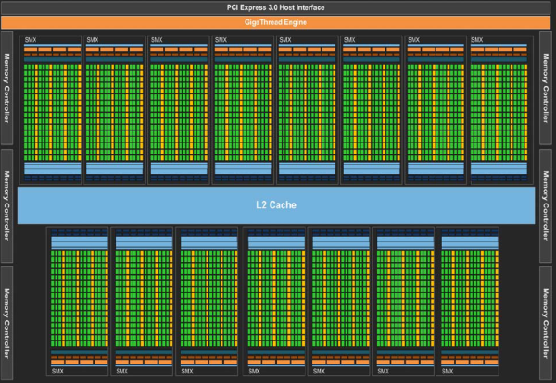
How do we execute code on a GPU: The SIMT model (Single Instruction Multiple Thread)
Turn source code into a scalar work-item
Map work-items onto an an N dim index space.
Run on hardware designed around the same SIMT execution model
extern void reduce( __local float*, __global float*);
__kernel void pi( const int niters, float step_size, __local float* l_sums, __global float* p_sums)
{
int n_wrk_items = get_local_size(0);
int loc_id = get_local_id(0);
int grp_id = get_group_id(0);
float x, accum = 0.0f; int i,istart,iend;
istart = (grp_id * n_wrk_items + loc_id) * niters;
iend = istart+niters;
for(i= istart; i<iend; i++){
x = (i+0.5f)*step_size; accum += 4.0f/(1.0f+x*x); }
l_sums[local_id] = accum;
barrier(CLK_LOCAL_MEM_FENCE);
reduce(l_sums, p_sums);
}
Map data structures onto the same index space
This is OpenCL kernel code … the sort of code the OpenMP compiler generates on your behalf
Third Party names are the property of their owners

Slide 41
How do we execute code on a GPU: OpenCL and CUDA nomenclature
Organize work-items into work-groups and map onto an an N dim index space. Cuda calls a work-group a thread-block
Turn source code into a scalar work-item (a CUDA thread)
Submit a kernel to an OpenCL command queue or a CUDA stream
extern void reduce( __local float*, __global float*);
__kernel void pi( const int niters, float step_size, __local float* l_sums, __global float* p_sums)
{
int n_wrk_items = get_local_size(0);
int loc_id = get_local_id(0);
int grp_id = get_group_id(0);
float x, accum = 0.0f; int i,istart,iend;
istart = (grp_id * n_wrk_items + loc_id) * niters;
iend = istart+niters;
for(i= istart; i<iend; i++){
x = (i+0.5f)*step_size; accum += 4.0f/(1.0f+x*x); }
l_sums[local_id] = accum;
barrier(CLK_LOCAL_MEM_FENCE);
reduce(l_sums, p_sums);
}
OpenCL index space is called an NDRange. CUDA calls this a Grid
This code defines a kernel
It’s called SIMT, but GPUs are really vector-architectures with a block of work-items executing together (a subgroup in OpenCL or a warp with Cuda)
Third Party names are the property of their owners

Slide 42

CUDA Toolkit
The CUDA toolkit works with code written in OpenMP 4.5 without any changes
We will demonstrate using an OpenMP 4.5 version of flow
Hydrodynamics mini-app solving Euler’s compressible equations
Explicit 2D method that uses various stencils, keeping data resident on GPU for entire solve

Slide 43
CUDA Toolkit: NVProf
Simple profiling: nvprof ./exe <params>
Time to copy data onto GPU
Time to copy data back from GPU
Profiling data
Timings for computational kernels

Slide 44
CUDA Toolkit: NVProf
Trace profiling: nvprof --print-gpu-trace ./exe <params>
Shows block sizes, grid dimensions and register counts for kernels
Entries ordered by time

Slide 45
Other CUDA Toolkit tools
nvidia-smi – displays some information about NVIDIA devices on a node
cudagdb – command line debugger in the style of GDB that allows kernel debugging
cuda-memcheck – tool to catch memory access errors in a CUDA application
nvvp – visual optimisation application that can use profiling data from nvprof

Slide 46
Exercise
Use the Pi program from the previous exercise and explore how it executes on a GPU using nvprof.
nvprof ./pi
nvprof --print-gpu-trace ./pi
Is a kernel run on the GPU?
Where is all the time going?
You will need to edit the job submission files to submit the job to the queue with nvprof. For example:
Replace the line
./pi
with the line (for example)
nvprof --print-gpu-trace ./pi

Slide 47
Agenda
OpenMP overview
The device model in OpenMP
Understanding execution on the GPU with nvprof
Moving memory to/from the device
Working with the target directive
Controlling memory movement
Optimizing GPU code
CPU/GPU portability
5-point stencil
OpenMP 5.0

Slide 48
Explicit Data Sharing
Previously, we described the rules for implicit data movement.
We explicitly control the movement of data using the map clause.
Data allocated on the heap needs to explicitly copied to/from the device:
int main(void) {
int ii=0, N = 1024;
int* A = malloc(sizeof(int)*N);
#pragma omp target
{
// N, ii and A all exist here
// The data that A points to (*A , A[ii]) DOES NOT exist here!
} }

Slide 49
Controlling data movement
Data movement defined from the host perspective.
int i, a[N], b[N], c[N];
#pragma omp target map(to:a,b) map(tofrom:c)
The various forms of the map clause
map(to:list): On entering the region, variables in the list are initialized on the device using the original values from the host (host to device copy).
map(from:list): At the end of the target region, the values from variables in the list are copied into the original variables (device to host copy). On entering the region, initial value of the variable is not initialized.
map(tofrom:list): the effect of both a map-to and a map-from (host to device copy at start of region, device to host copy at end)
map(alloc:list): On entering the region, data is allocated and uninitialized on the device.
map(list): equivalent to map(tofrom:list).
For pointers you must use array section notation ..
map(to:a[0:N]). Notation is A[lower-bound : length]

Slide 50
Moving arrays with the map clause
int main(void) {
int N = 1024;
int* A = malloc(sizeof(int)*N);
#pragma omp target map(A[0:N])
{
// N, ii and A all exist here
// The data that A points to DOES exist here!
} }
Default mapping map(tofrom: A[0:N])
Copy at start and end of target region.

Slide 51
Our running example: Jacobi solver
An iterative method to solve a system of linear equations
Given a matrix A and a vector b find the vector x such that Ax=b
The basic algorithm:
Write A as a lower triangular (L), upper triangular (U) and diagonal matrix
Ax = (L+D+U)x = b
Carry out multiplications and rearrange
Dx=b-(L+U)x → x = (b-(L+U)x)/D
Iteratively compute a new x using the x from the previous iteration
X_{new} = (b-(L+U)x_{old})/D
Advantage: we can easily test if the answer is correct by multiplying our final x by A and comparing to b
Disadvantage: It takes many iterations and only works for diagonally dominant matrices

Slide 52
Jacobi Solver
Iteratively update xnew until the value stabilizes (i.e. change less than a preset TOL)
// test convergence
conv = 0.0;
for (i=0; i<Ndim; i++){
tmp = xnew[i]-xold[i];
conv += tmp*tmp;
}
conv = sqrt((double)conv);
// swap pointers for next
// iteration
TYPE* tmp = xold;
xold = xnew;
xnew = tmp;
} // end while loop
<<< allocate and initialize the matrix A >>>
<<< and vectors x1, x2 and b >>>
while((conv > TOL) && (iters<MAX_ITERS))
{
iters++;
for (i=0; i<Ndim; i++){
xnew[i] = (TYPE) 0.0;
for (j=0; j<Ndim;j++){
if(i!=j)
xnew[i]+= A[i*Ndim + j]*xold[j];
}
xnew[i] = (b[i]-xnew[i])/A[i*Ndim+i];
}

Slide 53
Exercise: Jacobi solver
Start from the provided jacobi_solver program. Verify that you can run it serially.
Parallelize for a CPU using the parallel for construct on the major loops
Use the target directive to run on a GPU.
#pragma omp target
#pragma omp target map(to:list) map(from:list) map(tofrom:list)

Slide 54
Jacobi Solver (Par Targ, 1/2)
while((conv > TOL) && (iters<MAX_ITERS))
{
iters++;
#pragma omp target map(tofrom:xnew[0:Ndim],xold[0:Ndim]) \
map(to:A[0:Ndim*Ndim], b[0:Ndim] )
for (i=0; i<Ndim; i++){
xnew[i] = (TYPE) 0.0;
for (j=0; j<Ndim;j++){
if(i!=j)
xnew[i]+= A[i*Ndim + j]*xold[j];
}
xnew[i] = (b[i]-xnew[i])/A[i*Ndim+i];
}

Slide 55
Jacobi Solver (Par Targ, 2/2)
//
// test convergence
//
conv = 0.0;
#pragma omp target map(to:xnew[0:Ndim],xold[0:Ndim])
for (i=0; i<Ndim; i++){
tmp = xnew[i]-xold[i];
conv += tmp*tmp;
}
conv = sqrt((double)conv);
TYPE* tmp = xold;
xold = xnew;
xnew = tmp;
} // end while loop

Slide 56
Agenda
OpenMP overview
The device model in OpenMP
Understanding execution on the GPU with nvprof
Moving memory to/from the device
Working with the target directive
Controlling memory movement
Optimizing GPU code
CPU/GPU portability
5-point stencil
OpenMP 5.0

Slide 57
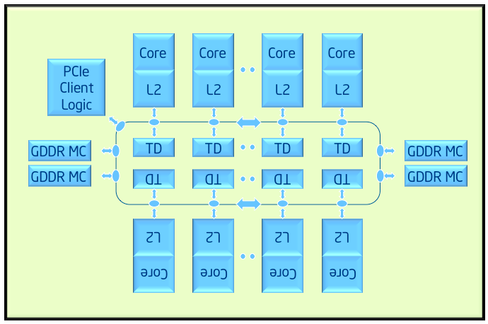
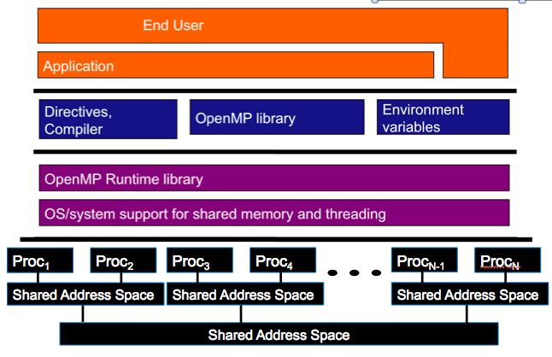
OpenMP device model: Examples
A couple key devices we considered when designing the device model in OpenMP
Target Device: Intel® Xeon Phi™ processor
Host
Target Device: GPU

Slide 58
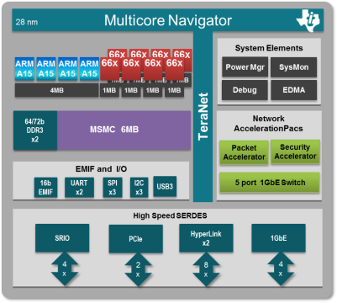
OpenMP Device Model: another example
Heterogeneous SoC

Slide 59
A Generic Host/Device Platform Model
…
…
…
…
…
…
…
Processing Element
…
…
Host
…
…
…
…
…
…
Compute Unit
Device
One Host and one or more Devices
Each Device is composed of one or more Compute Units
Each Compute Unit is divided into one or more Processing Elements
Memory divided into host memory and device memory
Third party names are the property of their owners.

Slide 60
Our host/device Platform Model and OpenMP
…
…
…
…
…
…
…
Processing Element
…
…
Host
…
…
…
…
…
…
Target construct to get onto a device
Compute Unit
Device
Parallel for simd to run each block of loop iterations on the processing elements
Teams construct to create a league of teams with one team of threads on each compute unit.
Distribute construct to assign blocks of loop iterations to teams.

Slide 61
Our host/device Platform Model and OpenMP
Typical usage ... let the compiler do what’s best for the device:
…
…
…
#pragma omp target
to get on the device
…
…
…
…
Processing Element
…
…
Host
…
…
…
…
…
…
Target construct to get onto a device
Compute Unit
Device
Parallel for simd to run each block of loop iterations on the processing elements
Teams construct to create a league of teams with one team of threads on each compute unit.
Distribute construct to assign blocks of loop iterations to teams.
#pragma omp teams distribute parallel for simd
to assign work to the device processing elements

Slide 62
Review: Loop worksharing
Sequential code
for(i=0;I<N;i++) { a[i] = a[i] + b[i];}
#pragma omp parallel
{
int id, i, Nthrds, istart, iend;
id = omp_get_thread_num();
Nthrds = omp_get_num_threads();
istart = id * N / Nthrds;
iend = (id+1) * N / Nthrds;
for(i=istart;I<iend;i++) {a[i]=a[i]+b[i];}
}
OpenMP Parallel Region
OpenMP Parallel Region and a work-sharing for construct
#pragma omp parallel
#pragma omp for schedule(static)
for(i=0;I<N;i++) {
a[i]=a[i]+b[i];
}

Slide 63
Review: Loop worksharing
#pragma omp parallel for reduction(+:s)
for (int i=0; i<N; i++)
s += x[i] * c[i];
B1=0; E2=N/4; s1=0;
for (i1=B1; i1<E1; i1++)
s1 += x[i1]*c[i1];
B2=N/4; E2=N/2; s2=0;
for (i2=B2; i2<E2; i2++)
s2 += x[i2]*c[i2];
B3=N/2; E3=3*N/4; s3=0;
for (i3=B3; i3<E3; i3++)
s3 += x[i3]*c[i3];
B4=3*N/4; E4=N; s4=0;
for (i4=B4; i4<E4; i4++)
s4 += x[i4]*c[i4];
s = s1+s2+s3+s4;
A single copy of x[] and c[] is shared by all the threads

Slide 64
Consider the familiar VADD example
#include <omp.h>
#include <stdio.h>
#define N 1024
int main()
{
float a[N], b[N], c[N];
int i;
// initialize a, b and c ….
for(i=0;i<N;i++)
c[i] += a[i] + b[i];
// Test results, report results …
}
The challenge:
How to workshare the VADD loop across the hierarchy of compute units and processing elements
The strategy:
Chunk loop level 1: distribute big chunks of loop iterations to teams running on compute units (thread blocks, coherency domains, card, etc...)
Chunk loop level 2: loop workshare the iterations in a distributed chunk across threads in a team.
Chunk loop level 3: Use simd level parallelism inside each thread.

Slide 65
Accelerated Worksharing
64 iterations assigned to 2 teams; Each team has 4 threads; Each thread has 2 SIMD lanes
Distribute Iterations across 2 teams
0 | 1 | 2 | 3 | 4 | 5 | 6 | 7 | 8 | 9 | 10 | 11 | 12 | 13 | 14 | 15 | 16 | 17 | 18 | 19 | 20 | 21 | 22 | 23 | 24 | 25 | 26 | 27 | 28 | 29 | 30 | 31 | 32 | 33 | 34 | 35 | 36 | 37 | 38 | 39 | 40 | 41 | 42 | 43 | 44 | 45 | 46 | 47 | 48 | 49 | 50 | 51 | 52 | 53 | 54 | 55 | 56 | 57 | 58 | 59 | 60 | 61 | 62 | 63
In a team workshare iterations across 4 threads
0 | 1 | 2 | 3 | 4 | 5 | 6 | 7 | 8 | 9 | 10 | 11 | 12 | 13 | 14 | 15 | 16 | 17 | 18 | 19 | 20 | 21 | 22 | 23 | 24 | 25 | 26 | 27 | 28 | 29 | 30 | 31
32 | 33 | 34 | 35 | 36 | 37 | 38 | 39 | 40 | 41 | 42 | 43 | 44 | 45 | 46 | 47 | 48 | 49 | 50 | 51 | 52 | 53 | 54 | 55 | 56 | 57 | 58 | 59 | 60 | 61 | 62 | 63
In a thread use SIMD parallelism
0 | 1 | 2 | 3 | 4 | 5 | 6 | 7
8 | 9 | 10 | 11 | 12 | 13 | 14 | 15
16 | 17 | 18 | 19 | 20 | 21 | 22 | 23
24 | 25 | 26 | 27 | 28 | 29 | 30 | 31
32 | 33 | 34 | 35 | 36 | 37 | 38 | 39
40 | 41 | 42 | 43 | 44 | 45 | 46 | 47
48 | 49 | 50 | 51 | 52 | 53 | 54 | 55
56 | 57 | 58 | 59 | 60 | 61 | 62 | 63

Slide 66
Accelerated workshare v1.0
Host thread
Simply add a target construct
Transfer control of execution to a SINGLE device thread
Only one team of threads workshares the loop
Device initial thread
#pragma omp target
#pragma omp parallel for
for (i=0;i<N;i++)
…
Device
thread
team

Slide 67
Exercise: Accelerate Pi v1.0
Use the target construct to offload the parallel Pi program to an accelerator.
#include <omp.h>
static long num_steps = 100000;
double step;
void main ()
{
double pi, sum=0.0;
step = 1.0/(double) num_steps;
#pragma omp parallel
{
double x;
#pragma omp for reduction(+:sum)
for (int i=0; i< num_steps; i++){
x = (i+0.5)*step;
sum = sum + 4.0/(1.0+x*x);
}
}
pi = step * sum;
}
Start with a CPU friendly, multithreaded version of the program
Use Nvprof to compare the offloaded serial pi program we wrote earlier to this offloaded parallel pi program..

Slide 68
teams and distribute constructs
The teams construct
Similar to the parallel construct
It starts a league of thread teams
Each team in the league starts as one initial thread – a team of one
Threads in different teams cannot synchronize with each other
The construct must be “perfectly” nested in a target construct
The distribute construct
Similar to the for construct
Loop iterations are workshared across the initial threads in a league
No implicit barrier at the end of the construct
dist_schedule(kind[, chunk_size])
If specified, scheduling kind must be static
Chunks are distributed in round-robin fashion in chunks of size chunk_size
If no chunk size specified, chunks are of (almost) equal size; each team receives at least one chunk

Slide 69
Accelerated workshare v2.0
teams construct
distribute construct
Transfer execution control to MULTIPLE device initial threads
Workshare loop iterations across the initial threads.
host thread
device initial threads
#pragma omp target
#pragma omp teams
#pragma omp distribute
for (i=0;i<N;i++)
…
teams

Slide 70
Exercise: Accelerate Pi v2.0
Modify your Pi example to use the teams and distribute constructs.
For this exercise do NOT use the parallel and for constructs
{
int i; double x, pi, sum = 0.0;
step = 1.0/(double) num_steps;
#pragma omp parallel
{
double x;
#pragma omp for reduction(+:sum)
for (i=0; i< num_steps; i++){
x = (i+0.5)*step;
sum = sum + 4.0/(1.0+x*x);
}
}
pi = step * sum;
}
Start with a serial version of the program
Use Nvprof to understand how this version of the program maps onto a GPU..

Slide 71
Accelerate workshare v3.0
teams distribute
parallel for simd
Transfer execution control to MULTIPLE device initial threads
Workshare loop iterations across the initial threads (teams distribute)
Each initial thread becomes the master thread in a thread team
Workshare loop iterations across the threads in a team (parallel for)
host thread
device thread teams
#pragma omp target
#pragma omp teams distribute
for (i=0;i<N;i++)
#pragma omp parallel for simd
for (j=0;j<M;i++)
…

Slide 72
Exercise: Accelerate Pi v3.0
Modify your Pi example to use teams, distribute and parallel for simd constructs.
Hint: omp_get_num_teams() returns the number of teams executing a teams region
{
int i; double x, pi, sum = 0.0;
step = 1.0/(double) num_steps;
#pragma omp target map(sum)
#pragma omp teams reduction(+: sum)
{
double x;
#pragma omp distribute
for (int i=0; i< num_steps; i++){
x = (i+0.5)*step;
sum = sum + 4.0/(1.0+x*x);
}
}
pi = step * sum;
}

Slide 73
Multiple thread teams in parallel
#pragma omp target map(sum)
#pragma omp teams reduction(+:sum)
{
int block_size = num_steps/omp_get_num_teams();
#pragma omp distribute dist_sched(static, 1)
for (int ii = 0; ii < num_steps; ii += block_size){
#pragma omp parallel for simd reduction(+: sum)
for (int i = ii; i < MIN(ii+block_size, num_steps); i++) {
sum = …
}}
}
workshare (w/o barrier)
workshare (w/ barrier)

Slide 74
Combined Constructs
The distribution patterns can be cumbersome
OpenMP defines composite constructs for typical code patterns
distribute simd
distribute parallel for
distribute parallel for simd
... plus additional combinations for teams and target
Let the compiler figure out the loop tiling
#pragma omp target teams
{
#pragma omp distribute parallel for simd
for (int i = 0; i < n; i++) {
F(i) = G(i);
}
}

Slide 75
Accelerate Pi v4.0
Modify your Pi example to use the teams distribute parallel for simd construct.
Feel free to update your Pi code and try it…
{ int i; double x, pi, sum = 0.0;
step = 1.0/(double) num_steps;
#pragma omp target map(sum)
#pragma omp teams distribute parallel for simd \
reduction(+: sum) private(x)
for (i=0; i< num_steps; i++){
x = (i+0.5)*step;
sum = sum + 4.0/(1.0+x*x);
}
pi = step * sum;
}

Slide 76
Commonly used clauses on teams distribute parallel for simd
The basic construct is:
#pragma omp teams distribute parallel for simd [clause[[,]clause]...]
for-loops
The most commonly used clauses are:
private(list) firstprivate(list) lastprivate(list) shared(list)
behave as data environment clauses in the rest of OpenMP, but note values are only created or copied into the region, not back out “at the end”.
reduction(reduction-identifier : list)
behaves as in the rest of OpenMP … but the variable must appear in a map(tofrom) clause on the associated target construct in order to get the value back out at the end
collapse(n)
Combines loops before the distribute directive splits up the iterations between teams
dist_schedule(kind[, chunk_size])
only supports kind= static. Otherwise works the same as when applied to a for construct. Note: this applies to the operation of the distribute directive and controls distribution of loop iterations onto teams (NOT the distribution of loop iterations inside a team).

Slide 77
Exercise:
Modify your Jacobi solver to use the teams distribute parallel for simd construct.
Compare the runtimes of our jacobi solvers and use Nvprof to understand how the two program execute.

Slide 78
Jacobi Solver (Par Targ, 1/2)
while((conv > TOL) && (iters<MAX_ITERS))
{
iters++;
#pragma omp target map(tofrom:xnew[0:Ndim],xold[0:Ndim]) \
map(to:A[0:Ndim*Ndim], b[0:Ndim])
#pragma omp teams distribute parallel for simd private(i,j)
for (i=0; i<Ndim; i++){
xnew[i] = (TYPE) 0.0;
for (j=0; j<Ndim;j++){
if(i!=j)
xnew[i]+= A[i*Ndim + j]*xold[j];
}
xnew[i] = (b[i]-xnew[i])/A[i*Ndim+i];
}

Slide 79
Jacobi Solver (Par Targ, 2/2)
//
// test convergence
//
conv = 0.0;
#pragma omp target map(to:xnew[0:Ndim],xold[0:Ndim]) \
map(tofrom:conv)
#pragma omp teams distribute parallel for simd \
private(i,tmp) reduction(+:conv)
for (i=0; i<Ndim; i++){
tmp = xnew[i]-xold[i];
conv += tmp*tmp;
}
conv = sqrt((double)conv);
TYPE* tmp = xold;
xold = xnew;
xnew = tmp;
} // end while loop

Slide 80
Jacobi Solver (Par Targ, 2/2)
//
// test convergence
//
conv = 0.0;
#pragma omp target map(to:xnew[0:Ndim],xold[0:Ndim]) \
map(tofrom:conv)
#pragma omp teams distribute parallel for simd \
private(i,tmp) reduction(+:conv)
for (i=0; i<Ndim; i++){
tmp = xnew[i]-xold[i];
conv += tmp*tmp;
}
conv = sqrt((double)conv);
} // end while loop
This worked but the performance was awful. Why?
System | Implementation | Ndim = 4096
NVIDA® K20X™ GPU | Target dir per loop | 131.94 secs
Cray® XC40™ Supercomputer running Cray® Compiling Environment 8.5.3. Intel® Xeon ® CPU E5-2697 v2 @ 2.70GHz with 32 GB DDR3. NVIDIA® Tesla® K20X, 6GB.
Third party names are the property of their owners.

Slide 81
Data movement dominates!!!
while((conv > TOLERANCE) && (iters<MAX_ITERS))
{ iters++;
xnew = iters % s ? x2 : x1;
xold = iters % s ? x1 : x2;
#pragma omp target map(tofrom:xnew[0:Ndim],xold[0:Ndim]) \
map(to:A[0:Ndim*Ndim], b[0:Ndim] )
#pragma omp teams distribute parallel for simd private(i,j)
for (i=0; i<Ndim; i++){
xnew[i] = (TYPE) 0.0;
for (j=0; j<Ndim;j++){
if(i!=j)
xnew[i]+= A[i*Ndim + j]*xold[j];
}
xnew[i] = (b[i]-xnew[i])/A[i*Ndim+i];
}
// test convergence
conv = 0.0;
#pragma omp target map(to:xnew[0:Ndim],xold[0:Ndim]) \
map(tofrom:conv)
#pragma omp teams distribute parallel for private(i,tmp) reduction(+:conv)
for (i=0; i<Ndim; i++){
tmp = xnew[i]-xold[i];
conv += tmp*tmp;
}
conv = sqrt((double)conv);
}
Typically over 4000 iterations!
For each iteration, copy to device (3*Ndim+Ndim²)*sizeof(TYPE) bytes
For each iteration, copy from device 2*Ndim*sizeof(TYPE) bytes
For each iteration, copy to device 2*Ndim*sizeof(TYPE) bytes

Slide 82
Comparing OpenMP with OpenACC
OpenMP 4.0 – accelerated workshare
OpenACC – accelerated workshare
#pragma omp target teams map(B[0:N]) num_teams(numblocks)
#pragma omp distribute parallel for
for (i=0; i<N; ++1) {
B[i] += sin(B[i]);
}
#pragma acc parallel copy(B[0:N]) num_gangs(numblocks)
#pragma acc loop gang worker
for (i=0; i<N; ++i) {
B[i] += sin(B[i]);
}

Slide 83
Agenda
OpenMP overview
The device model in OpenMP
Understanding execution on the GPU with nvprof
Moving memory to/from the device
Working with the target directive
Controlling memory movement
Optimizing GPU code
CPU/GPU portability
5-point stencil
OpenMP 5.0

Slide 84
Target data directive
The target data construct creates a target data region.
You use the map clauses for explicit data management #pragma omp target data map(to: A,B) map(from: C) {….} // a structured block of code
Data is copied into the device data environment at the beginning of the directive and at the end
Inside the target data region, multiple target regions can work with the single data region #pragma omp target data map(to:A, B) map(from: C) { #pragma omp target {do lots of stuff with A, B and C} {do something on the host} #pragma omp target {do lots of stuff with A, B, and C} }

Slide 85
Target update directive
You can update data between target regions with the target update directive.
Set up the data region ahead of time.
#pragma omp target data map(to: A,B) map(from: C)
{
#pragma omp target
{do lots of stuff with A, B and C}
#pragma omp target update from(A)
host_do_something_with(A)
#pragma omp target update to(A)
#pragma omp target
{do lots of stuff with A, B, and C}
}
Copy A on the device to A on the host.
Copy A on the host to A on the device.

Slide 86
Target enter/exit data constructs
The target data construct requires a structured block of code.
Often inconvenient in real codes.
Can achieve similar behavior with two standalone directives: #pragma omp target enter data map(…) #pragma omp target exit data map(…)
The target enter data maps variables to the device data environment.
The target exit data unmaps variables from the device data environment.
Future target regions inherit the existing data environment.

Slide 87
Target enter/exit data example
void init_array(int *A, int N) {
for (int i = 0; i < N; ++i) A[i] = i; #pragma omp target enter data map(to: A[0:N])
}
int main(void) { int N = 1024; int *A = malloc(sizeof(int) * N);
init_array(A, N);
#pragma omp target teams distribute parallel for simd for (int i = 0; i < N; ++i) A[i] = A[i] * A[i];
#pragma omp target exit data map(from: A[0:N])
}

Slide 88
Exercise
Modify your parallel jacobi_solver from the last exercise.
Use the target data construct to create a data region. Manage data movement with map clauses to minimize data movement.
#pragma omp target
#pragma omp target enter data
#pragma omp target exit data
#pragma omp target update
#pragma omp target map(to:list) map(from:list) map(tofrom:list)
#pragma omp parallel for reduction(+:var) private(list)

Slide 89
Jacobi Solver (Par Targ Data, 1/2)
#pragma omp target enter data map(to: xold[0:Ndim], xnew[0:Ndim], \
A[0:Ndim*Ndim], b[0:Ndim] )
while((conv > TOL) && (iters<MAX_ITERS))
{ iters++;
#pragma omp target
#pragma omp teams distribute parallel for simd private(j)
for (i=0; i<Ndim; i++){
xnew[i] = (TYPE) 0.0;
for (j=0; j<Ndim;j++){
if(i!=j)
xnew[i]+= A[i*Ndim + j]*xold[j];
}
xnew[i] = (b[i]-xnew[i])/A[i*Ndim+i];
}

Slide 90
Jacobi Solver (Par Targ Data, 2/2)
// test convergence
conv = 0.0;
#pragma omp target map(tofrom: conv)
{
#pragma omp teams distribute parallel for simd \
private(tmp) reduction(+:conv)
for (i=0; i<Ndim; i++){
tmp = xnew[i]-xold[i];
conv += tmp*tmp;
}
} // end target region
conv = sqrt((double)conv);
TYPE* tmp = xold;
xold = xnew;
xnew = tmp;
} // end while loop
#pragma omp target exit data map(from: xold[0:Ndim], xnew[0:Ndim])
System | Implementation | Ndim = 4096
NVIDA® K20X™ GPU | Target dir per loop | 131.94 secs
 | Above plus target data region | 18.37 secs
Third party names are the property of their owners.

Slide 91
Target update details
#pragma omp target update clause[[[,]clause]...]
Creates a target task to handle data movement between the host and a device.
clause is either motion-clause or one of the following:
if(scalar-expression)
device(integer-expression)
nowait
depend (dependence-type : list)
The motion-clause is one of the following:
to(list)
from(list)
nowait and depend apply to the target task running on the host.

Slide 92
Target enter/exit data details
#pragma omp target enter data clause[[[,]clause]...]
Creates a target task to handle data movement between the host and a device.
clause is one of the following:
if(scalar-expression)
device(integer-expression)
nowait
depend (dependence-type : list)
map (map-type: list)
nowait and depend apply to the target task running on the host.

Slide 93
A note about the nowait clause
Specify dependencies to ensure the target enter data finishes before the target region sibling task starts:
void init_array(int *A, int N) {
for (int i = 0; i < N; ++i) A[i] = i; #pragma omp target enter data map(to: A[0:N]) nowait depend(out: A)
}
int main(void) { int N = 1024; int *A = malloc(sizeof(int) * N);
init_array(A, N);
#pragma omp target teams distribute parallel for simd \ nowait depend(inout: A) for (int i = 0; i < N; ++i) A[i] = A[i] * A[i];
#pragma omp taskwait
#pragma omp target exit data map(from: A[0:N])
}

Slide 94
Data movement summary
Data transfers between host/device occur at:
Beginning and end of target region
Beginning and end of target data region
At the target enter data construct
At the target exit data construct
At the target update construct
Can use target data and target enter/exit data to reduce redundant transfers.
Use the target update construct to transfer data on the fly within a target data region or between target enter/exit data directives.

Slide 95
Agenda
OpenMP overview
The device model in OpenMP
Understanding execution on the GPU with nvprof
Moving memory to/from the device
Working with the target directive
Controlling memory movement
Optimizing GPU code
CPU/GPU portability
5-point stencil
OpenMP 5.0

Slide 96
Single Instruction Multiple Data
Individual work-items of a warp start together at the same program address
Each work-item has its own instruction address counter and register state
Each work-item is free to branch and execute independently
Supports the SPMD pattern.
Branch behavior
Each branch will be executed serially
Work-items not following the current branch will be disabled
A warp
Time
Start
Branch1
Branch2
Branch3
Converge

Slide 97
Branching
GPUs tend not to support speculative execution, which means that branch instructions have high latency
This latency can be hidden by switching to alternative work-items/work-groups, but avoiding branches where possible is still a good idea to improve performance
When different work-items executing within the same SIMD ALU array take different paths through conditional control flow, we have divergent branches (vs. uniform branches)
Divergent branches are bad news: some work-items will stall while waiting for the others to complete
We can use predication, selection and masking to convert conditional control flow into straight line code and significantly improve the performance of code that has lots of conditional branches
Notes:
Branches will cause pipeline stalls if there’s no branch prediction/speculative execution

Slide 98
Branching
Conditional execution
Selection and masking
// Only evaluate expression
// if condition is met
if (a > b)
{
acc += (a - b*c);
}
// Always evaluate expression
// and mask result
temp = (a - b*c);
mask = (a > b ? 1.f : 0.f);
acc += (mask * temp);
Notes:
Mask 0 if a <= b
Single-cycle multiply-add means we get the extra multiplication by the mask for free
No branches means there won’t be any pipeline stalls
Subtle point: more instruction level parallelism in second example: the mul and sub can be issued independently from the setp and selp on dual-issue architectures

Slide 99
Coalesced Access
Coalesced memory accesses are key for high performance code, especially on GPUs
In principle, it’s very simple, but frequently requires transposing/transforming data on the host before sending it to the GPU
Sometimes this is an issue of Array of Structures vs. Structure of Arrays (AoS vs. SoA)

Slide 100
Memory layout is critical to performance
“Structure of Arrays vs. Array of Structures”
Array of Structures (AoS) more natural to code
struct Point{ float x, y, z, a; };
Point *Points;
x | y | z | a | … | x | y | z | a | … | x | y | z | a | … | x | y | z | a | …
Structure of Arrays (SoA) suits memory coalescence in vector units
struct { float *x, *y, *z, *a; } Points;
Adjacent work-items/vector-lanes like to access adjacent memory locations
x | x | x | x | … | y | y | y | y | … | z | z | z | z | … | a | a | a | a | …

Slide 101
Coalescence
for (int id = 0; id < size; id++)
{
// ideal
float val1 = memA[id];
// still pretty good
const int c = 3;
float val2 = memA[id + c];
// stride size is not so good
float val3 = memA[c*id];
// terrible
const int loc =
some_strange_func(id);
float val4 = memA[loc];
}
Coalesce - to combine into one
Coalesced memory accesses are key for high bandwidth
Simply, it means, if thread i accesses memory location n then thread i+1 accesses memory location n+1
In practice, it’s not quite as strict…

Slide 102
Memory access patterns
0
1
2
3
4
5
6
7
GPU Threads
0x0f4
0x0f8
0x0fc
0x100
0x104
0x108
0x10c
0x110
0x114
0x118
0x11c
0x120
0x124
0x128
64 Byte Boundary
GPU Memory
64 Byte Boundary

Slide 103
Memory access patterns
float val1 = memA[id];
0
1
2
3
4
5
6
7
0x0f4
0x0f8
0x0fc
0x100
0x104
0x108
0x10c
0x110
0x114
0x118
0x11c
0x120
0x124
0x128
64 Byte Boundary

Slide 104

Memory access patterns
const int c = 3;
float val2 = memA[id + c];
0
1
2
3
4
5
6
7
0x114
0x118
0x11c
0x120
0x124
0x128
0x12c
0x130
0x134
0x138
0x13c
0x140
0x144
0x148
64 Byte Boundary

Slide 105
Memory access patterns
float val3 = memA[3*id];
0
1
2
3
4
5
6
7
0x0f4
0x0f8
0x0fc
0x100
0x104
0x108
0x10c
0x110
0x114
0x118
0x11c
0x120
0x124
0x128
Strided access results in multiple
memory transactions (and
kills throughput)
64 Byte Boundary

Slide 106
Memory access patterns
const int loc =
some_strange_func(id);
float val4 = memA[loc];
0
1
2
3
4
5
6
7
0x0f4
0x0f8
0x0fc
0x100
0x104
0x108
0x10c
0x110
0x114
0x118
0x11c
0x120
0x124
0x128
64 Byte Boundary

Slide 107
Exercise
Modify your parallel jacobi_solver from the last exercise.
Experiment with the optimizations we’ve discussed.
#pragma omp target
#pragma omp target data
#pragma omp target map(to:list) map(from:list) map(tofrom:list)
#pragma omp parallel for reduction(+:var) private(list)
Note: if you want to generate a transposed A matrix to try a different memory layout, you can use the following function from mm_utils
void init_colmaj_diag_dom_near_identity_matrix(int Ndim, TYPE *A)

Slide 108
Jacobi Solver (Par Targ Data, 1/2)
#pragma omp target enter data map(to: xold[0:Ndim], xnew[0:Ndim], \
A[0:Ndim*Ndim], b[0:Ndim] )
while((conv > TOL) && (iters<MAX_ITERS))
{ iters++;
#pragma omp target
#pragma omp teams distribute parallel for simd private(j)
for (i=0; i<Ndim; i++){
xnew[i] = (TYPE) 0.0;
for (j=0; j<Ndim;j++){
xnew[i]+= (A[i*Ndim + j]*xold[j])*((TYPE)(i != j));
}
xnew[i] = (b[i]-xnew[i])/A[i*Ndim+i];
}

Slide 109
Jacobi Solver (Par Targ Data, 2/2)
// test convergence
conv = 0.0;
#pragma omp target map(tofrom: conv)
#pragma omp teams distribute parallel for simd \
private(tmp) reduction(+:conv)
for (i=0; i<Ndim; i++){
tmp = xnew[i]-xold[i];
conv += tmp*tmp;
}
conv = sqrt((double)conv);
TYPE* tmp = xold;
xold = xnew;
xnew = tmp;
} // end while loop
#pragma omp target exit data map(from: xold[0:Ndim], xnew[0:Ndim])
System | Implementation | Ndim = 4096
NVIDA® K20X™ GPU | Target dir per loop | 131.94 secs
 | Above plus target data region | 18.37 secs
 | Above plus reduced branching | 13.74 secs
Cray® XC40™ Supercomputer running Cray® Compiling Environment 8.5.3. Intel® Xeon ® CPU E5-2697 v2 @ 2.70GHz with 32 GB DDR3. NVIDIA® Tesla® K20X, 6GB.
Third party names are the property of their owners.

Slide 110
Jacobi Solver (Targ Data/branchless/coalesced mem, 1/2)
#pragma omp target enter data map(to: xold[0:Ndim], xnew[0:Ndim], \
A[0:Ndim*Ndim], b[0:Ndim] )
while((conv > TOL) && (iters<MAX_ITERS))
{ iters++;
#pragma omp target
#pragma omp teams distribute parallel for simd private(j)
for (i=0; i<Ndim; i++){
xnew[i] = (TYPE) 0.0;
for (j=0; j<Ndim;j++){
xnew[i]+= (A[j*Ndim + i]*xold[j])*((TYPE)(i != j));
}
xnew[i] = (b[i]-xnew[i])/A[i*Ndim+i];
}
We replaced the original code with a poor memory access pattern
xnew[i]+= (A[i*Ndim + j]*xold[j])
With the more efficient
xnew[i]+= (A[j*Ndim + i]*xold[j])

Slide 111
Jacobi Solver (Targ Data/branchless/coalesced mem, 2/2)
//
// test convergence
conv = 0.0;
#pragma omp target map(tofrom: conv)
#pragma omp teams distribute parallel for simd \
private(tmp) reduction(+:conv)
for (i=0; i<Ndim; i++){
tmp = xnew[i]-xold[i];
conv += tmp*tmp;
}
conv = sqrt((double)conv);
TYPE* tmp = xold;
xold = xnew;
xnew = tmp;
} // end while loop
#pragma omp target exit data map(from: xold[0:Ndim], xnew[0:Ndim])
System | Implementation | Ndim = 4096
NVIDA® K20X™ GPU | Target dir per loop | 131.94 secs
 | Above plus target data region | 18.37 secs
 | Above plus reduced branching | 13.74 secs
 | Above plus improved mem access | 7.64 secs
Cray® XC40™ Supercomputer running Cray® Compiling Environment 8.5.3. Intel® Xeon ® CPU E5-2697 v2 @ 2.70GHz with 32 GB DDR3. NVIDIA® Tesla® K20X, 6GB.
Third party names are the property of their owners.

Slide 112
Agenda
OpenMP overview
The device model in OpenMP
Understanding execution on the GPU with nvprof
Moving memory to/from the device
Working with the target directive
Controlling memory movement
Optimizing GPU code
CPU/GPU portability
5-point stencil
OpenMP 5.0

Slide 113
Compiler Support
Intel began support for OpenMP 4.0 targeting their Intel Xeon Phi coprocessors in 2013 (compiler version 15.0). Compiler version 17.0 and later versions support OpenMP 4.5.
Cray provided the first vendor supported implementation targeting NVIDIA GPUs late 2015. The latest version of CCE now supports all of OpenMP 4.5.
IBM has recently completed a compiler implementation using Clang, that fully supports OpenMP 4.5. This is being introduced into the Clang main trunk.
Clang 7.0 supports OpenMP 4.5 offload to NVIDIA GPUs.
GCC 6.1 introduced support for OpenMP 4.5, and can target Intel Xeon Phi, or HSA-enabled AMD GPUs. V7 added support for NVIDIA GPUs.
PGI compilers don’t currently support OpenMP on GPUs (but they do for CPUs).
OpenMP compiler information: http://www.openmp.org/resources/openmp-compilers/
Third party names are the property of their owners.

Slide 114
Performance?
To test performance we use a mixture of synthetic benchmarks and mini-apps.
We compare against device-specific code written in OpenMP 3.0 and CUDA.
We eventually use OpenMP 4.x to run on every diverse architecture that we believe is currently supported.
Our initial expectations were low - we were able to achieve great performance on Intel Xeon Phi Knights Corner, but didn’t know what to expect on GPU.
Third party names are the property of their owners.

Slide 115
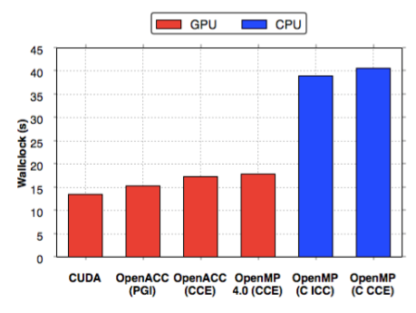
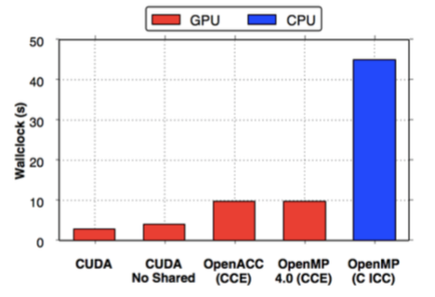
Performance?
* CCE 8.4.3, ICC 15.0.3, PGI 15.01, CUDA 7.0 on an NVIDIA® K20X, and Intel® Xeon® Haswell 16 Core Processor (E5-2698 v3 @ 2.30GHz)
CloverLeaf
Immediately we see impressive performance compared to CUDA
Clearly the Cray compiler leverages the existing OpenACC backend
BUDE
Even with OpenMP 4.5 there is still no way of targeting shared memory directly.
This is set to come in with OpenMP 5.0, and Clang supports targeting address spaces directly
Martineau, M., McIntosh-Smith, S. Gaudin, W., Evaluating OpenMP 4.0’s Effectiveness as a Heterogeneous Parallel Programming Model, 2016, HIPS’16
Third party names are the property of their owners.

Slide 116
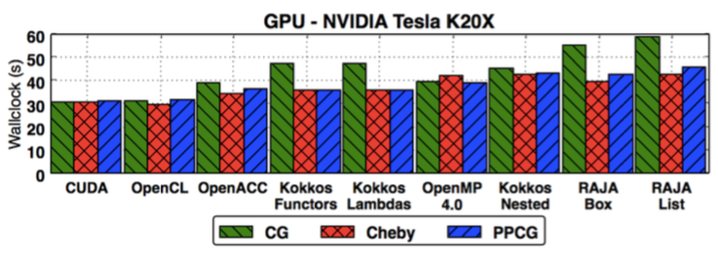
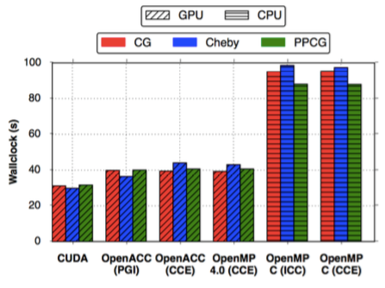
Performance?
* CCE 8.4.3, ICC 15.0.3, PGI 15.01, CUDA 7.0 on an NVIDIA® K20X, and Intel® Xeon® Haswell 16 Core Processor (E5-2698 v3 @ 2.30GHz)
TeaLeaf
We found that Cray’s OpenMP 4.0 implementation achieved great performance on a K20x
We see these figures continually improving as the languages mature
Martineau, M., McIntosh-Smith, S. Gaudin, W., Assessing the Performance Portability of Modern Parallel Programming Models using TeaLeaf, 2016, CC-PE
Third party names are the property of their owners.

Slide 117
How do you get good performance?
Our finding so far: You can achieve good performance on GPUs with OpenMP 4.x.
We achieved this by:
Keeping data resident on the device for the greatest possible time.
Collapsing loops with the collapse clause, so there was a large enough iteration space to saturate the device.
Using the simd directive to vectorize inner loops.
Using schedule(static, 1) for coalescence (obsolete).
Using nvprof of course.

Slide 118
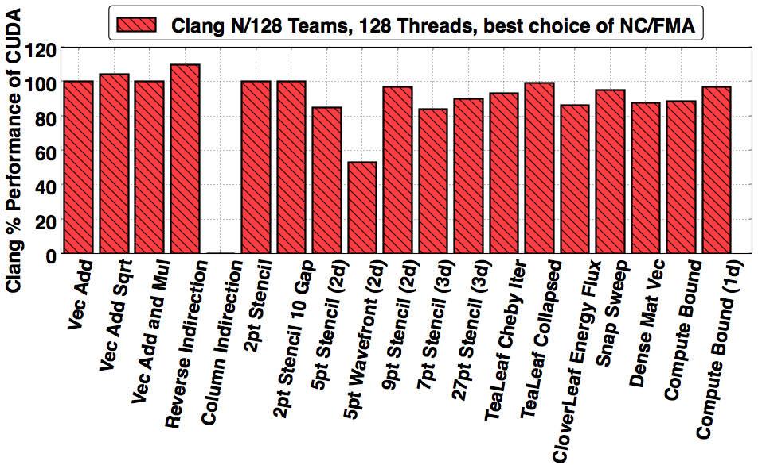
Can you do better?
* Clang copy https://github.com/clang-ykt, CUDA 8.0, NVIDIA K40m
Through extensive tuning of the compiler implementation we were able to execute CloverLeaf mini-app within 9% absolute runtime of hand optimized CUDA code…
Martineau, M., Bertolli, C., McIntosh-Smith, S., et al. Broad Spectrum Performance Analysis of OpenMP 4.5 on GPUs, 2016, PMBS’16
Third party names are the property of their owners.

Slide 119
Good. Performance… and Portability?
Up until this point we had implicitly proven a good level of portability as we had successfully run OpenMP 4.x on many devices (Intel® CPU, Intel Xeon® Phi™ processors, NVIDIA® GPUs).
The compiler support continually changes, improving performance, correctness and introducing new architectures.
We keep tracking this improvement over time.
Third party names are the property of their owners.

Slide 120
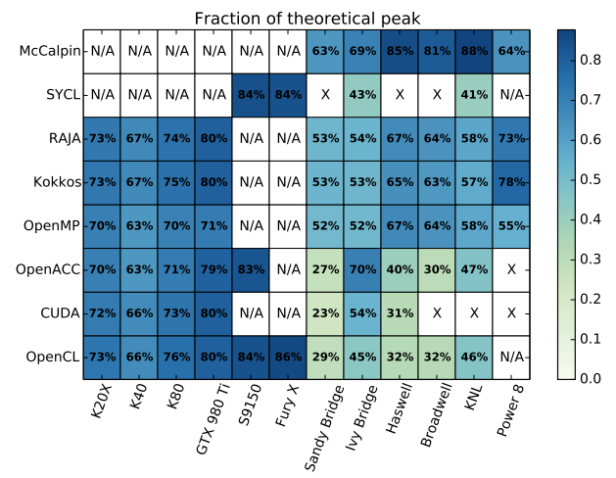
OpenMP in The Matrix.
System details on the following slide
On those supported target architectures, OpenMP achieves good performance
Deakin, T., Price, J., Martineau, M., McIntosh-Smith, S., GPU-STREAM v2.0 Benchmarking the achievable memory bandwidth of many-core processors across diverse parallel programming models, ISC’16
Third party names are the property of their owners.

Slide 121
System details
Abbreviation | System details
K20X | Cray® XC40, NVIDIA® K20X GPU, Cray compilers version 8.5, gnu 5.3, CUDA 7.5
K40 | Cray® CS cluster, NVIDIA® K40 GPU, Cray compilers version 8.4, gnu 4.9, CUDA 7.5
K80 | Cray® CS cluster, NVIDIA® K40 GPU, Cray compilers version 8.4, gnu 4.9, CUDA 7.5
S9150 | AMD® S9150 GPU. Codeplay® copmputeCpp compiler 2016.05 pre-release. AMD-APP OpenCL 1.2 (1912.5)drivers for SyCL. PGI® Accelerator)TM) 16.4 OpenACC
GTX 980 Ti | NVIDA® GTX 980 Ti. Clang-ykt fork of Clang for OpenMP. PGI® Accelerator™ 16.4 OpenACC. CUDA 7.5
Fury X | AMD® Fury X GPU (based on the Fiji architecture).
Sandy Bridge | Intel® Xeon® E5-2670 CPU. Intel® compilers release 16.0. PGI® Accelerator)TM) 16.4 OpenACC and CUDA-x86. Intel® OpenCL runtime 15.1. Codeplay® copmputeCpp compiler 2016.05 pre-release
Ivy Bridge | Intel® Xeon® E5-2697 CPU. Gnu 4.8 for RAJA and Kokkos, Intel® compiler version 16.0 for stream, Intel® OpenCL runtime 15.1. Codeplay® copmputeCpp compiler 2016.05 pre-release.
Haswell | Cray® XC40, Intel® Xeon® E5-2698 CPU. Intel® compilers release 16.0. PGI® Accelerator)TM) 16.3 OpenACC and CUDA-x86. Gnu 4.8 for RAJA and Kokkos
Broadwell | Cray® XC40, Intel® Xeon® E5-2699 CPU. Intel® compilers release 16.0. PGI® Accelerator)TM) 16.3 OpenACC and CUDA-x86. Gnu 4.8 for RAJA and Kokkos
KNL | Intel® Xeon® Phi™7210 (knights landing) Intel® compilers release 16.0. PGI® Accelerator)TM) 16.4 OpenACC with target specified as AVX2.
Power 8 | IBM® Power 8 processor with the XL 13.1 compiler.
Deakin, T., Price, J., Martineau, M., McIntosh-Smith, S., GPU-STREAM v2.0 Benchmarking the achievable memory bandwidth of many-core processors across diverse parallel programming models, ISC’16

Slide 122
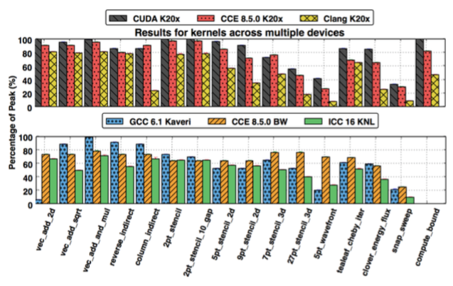
Nice - but beware of the caveat.
There is a MAJOR caveat - the directives were not identical.
Martineau, M., McIntosh-Smith, S. Gaudin, W., Pragmatic Performance Portability with OpenMP 4.x, 2016, IWOMP’16
Third party names are the property of their owners.

Slide 123
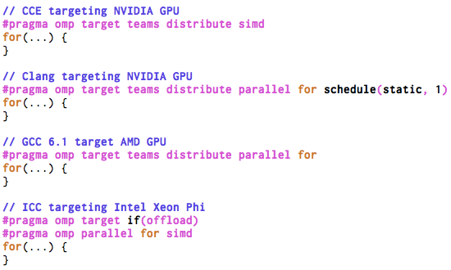
The worst case scenarios.
Four different ways of writing for the same kernel…

Slide 124
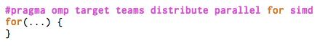
The answer:
If you can - just use the combined construct!
The compilers would accept the combined construct #pragma omp target teams distribute parallel for
This does not generalize to all algorithms unfortunately, but the majority can be adapted.
The construct makes a lot of guarantees to the compiler and it is very easy to reason about for good performance.

Slide 125
Caveats
If you can - just use the combined construct!
Real applications will have algorithms that are structured such that they can’t immediately use the combined construct.
The handling of clauses, such as collapse, can be tricky from a performance portability perspective.
Don’t be misguided… performance is possible without using the combined construct, but it likely won’t be consistent across architectures.

Slide 126
Performance
Portability
If you can - just use the combined construct!
Feature complete implementations will allow you to write performant code, and they will allow you to write portable code.
To get both will likely require algorithmic changes, and a careful approach to using OpenMP 4.5 in your application.
Avoid setting num_teams(nt) and thread_limit(tl) if you can, this is definitely not going to be performance portable.
Use collapse(n) in all situations where you expect the trip count of the outer loop to be short, but be aware that it can have a negative effect on CPU performance.
Use the combined construct whenever you can.

Slide 127
Agenda
OpenMP overview
The device model in OpenMP
Understanding execution on the GPU with nvprof
Moving memory to/from the device
Working with the target directive
Controlling memory movement
Optimizing GPU code
CPU/GPU portability
5-point stencil
OpenMP 5.0

Slide 128
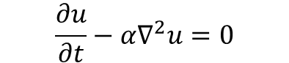
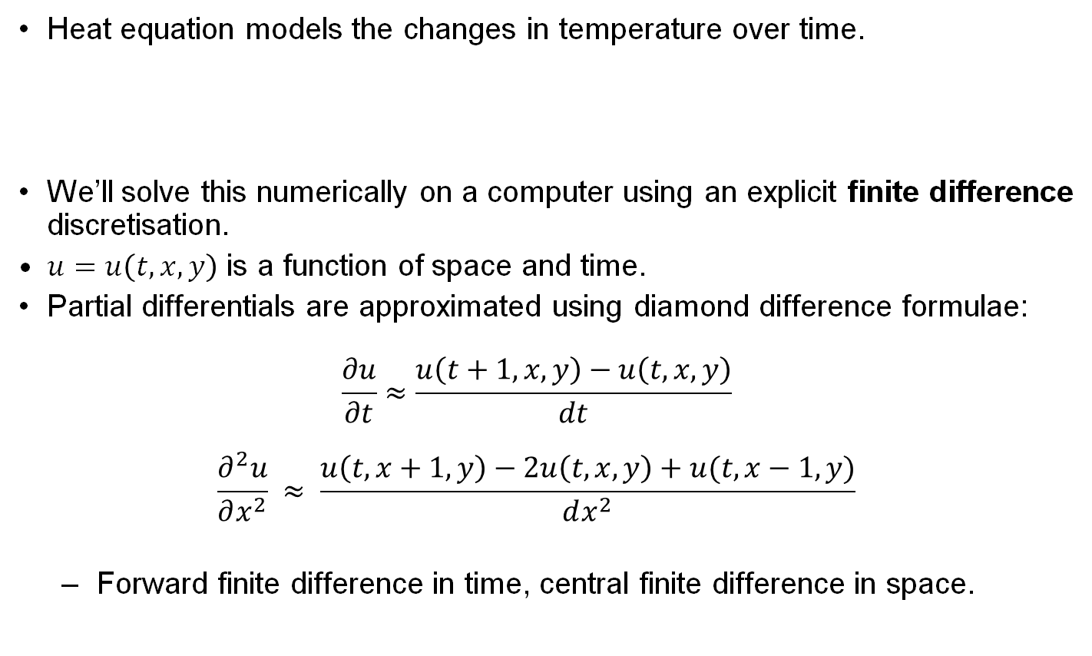
5-point stencil: the heat program
Heat equation models the changes in temperature over time.
We’ll solve this numerically on a computer using an explicit finite difference discretisation.
$u=u\left(t,x,y\right)$ is a function of space and time.
Partial differentials are approximated using diamond difference formulae: $\frac{∂u}{∂t}≈\frac{u\left(t+1, x, y\right)−u\left(t, x, y\right)}{dt}$ $\frac{∂^{2}u}{∂x^{2}} ≈ \frac{u\left(t,x+1, y\right)−2u\left(t,x,y\right)+u(t,x−1,y)}{dx^{2}}$
Forward finite difference in time, central finite difference in space.
$$\frac{∂u}{∂t}−{α∇}^{2}u=0$$

Slide 129
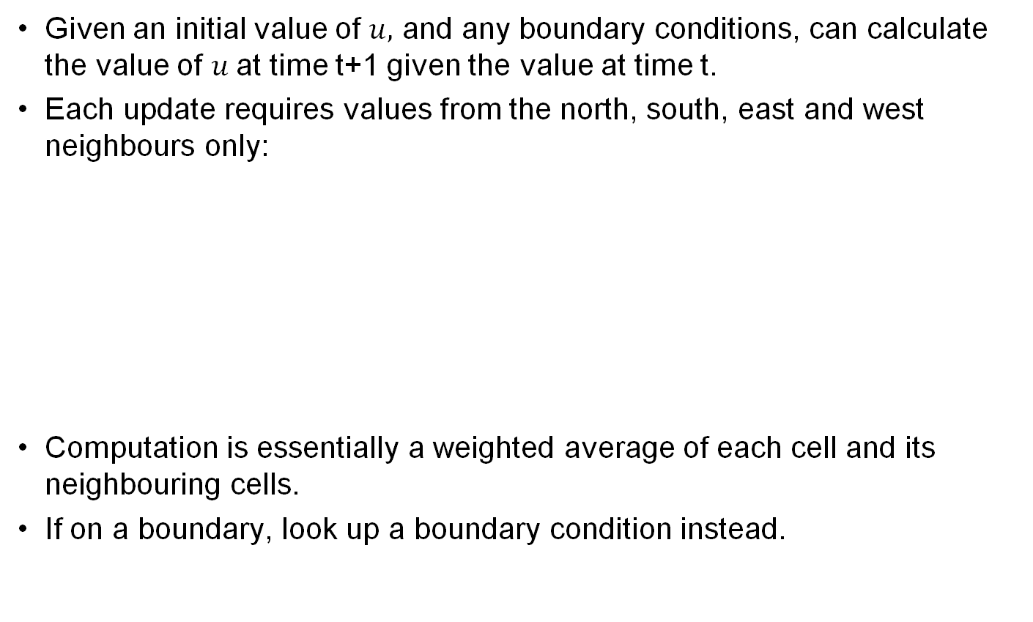
5-point stencil: the heat program
Given an initial value of $u,$ and any boundary conditions, can calculate the value of $u$at time t+1 given the value at time t.
Each update requires values from the north, south, east and west neighbours only:
Computation is essentially a weighted average of each cell and its neighbouring cells.
If on a boundary, look up a boundary condition instead.

Slide 130
Method of Manufactured Solution
Stencil codes are notoriously difficult to know if the answer is “correct”.
Analytic solutions hard to come by:
It’s why you’re using a computer to solve the equation approximately after all!
Method of Manufactured Solution (MMS) is a way to help determine if the code does the correct thing.
An approach often used to find errors in CFD codes and check convergence properties.

Slide 131
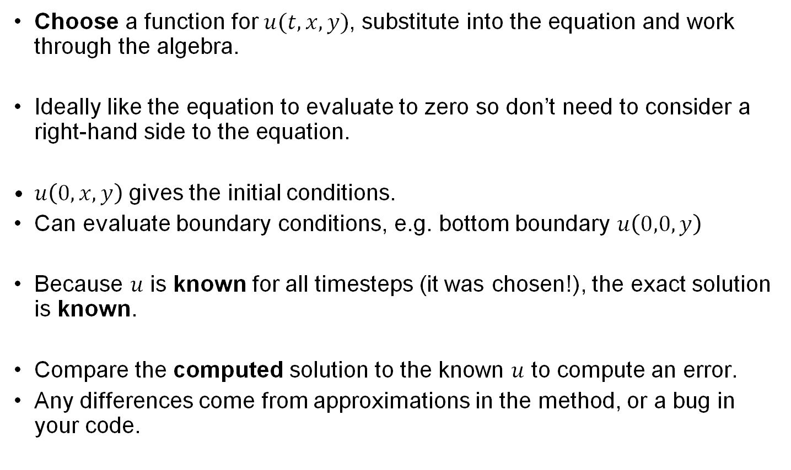
Method of Manufactured Solution
Choose a function for $u(t,x,y)$, substitute into the equation and work through the algebra.
Ideally like the equation to evaluate to zero so don’t need to consider a right-hand side to the equation.
$u\left(0,x,y\right)$ gives the initial conditions.
Can evaluate boundary conditions, e.g. bottom boundary $u\left(0,0,y\right)$
Because $u$ is known for all timesteps (it was chosen!), the exact solution is known.
Compare the computed solution to the known $u$ to compute an error.
Any differences come from approximations in the method, or a bug in your code.

Slide 132
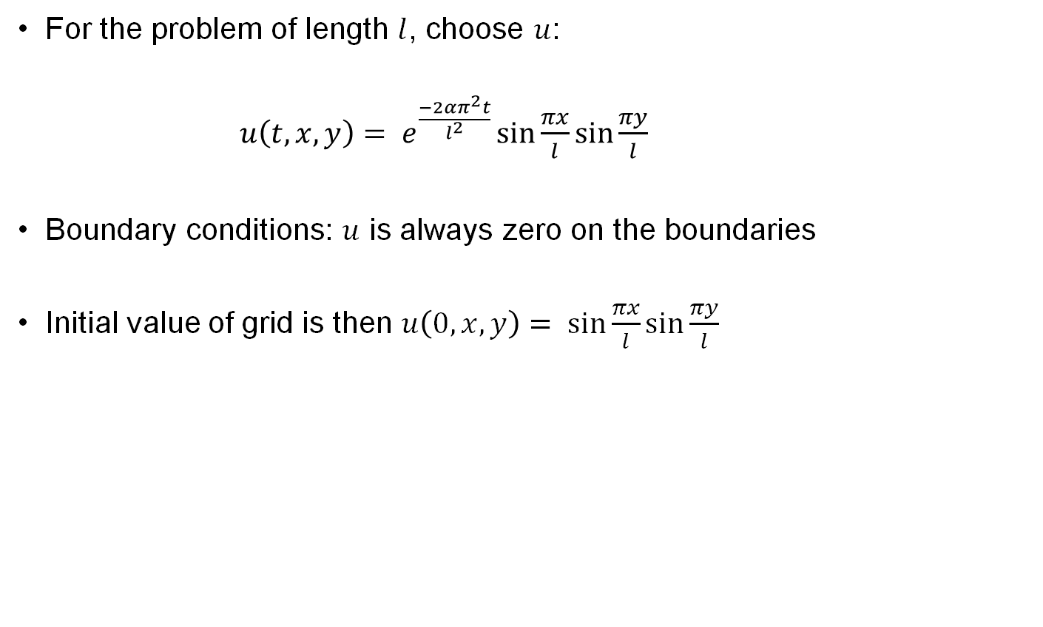
Method of Manufactured Solution
For the problem of length $l$, choose $u$:
$u\left(t,x,y\right)= e^{\frac{−2απ^{2}t}{l^{2}}}\sin{\frac{πx}{l}}\sin{\frac{πy}{l}}$
Boundary conditions: $u$ is always zero on the boundaries
Initial value of grid is then $u\left(0,x,y\right)= \sin{\frac{πx}{l}}\sin{\frac{πy}{l}}$

Slide 133
5-point stencil: solve kernel
void solve(…) {
// Finite difference constant multiplier
const double r = alpha * dt / (dx * dx);
const double r2 = 1.0 - 4.0*r;
// Loop over the nxn grid
for (int j = 0; j < n; ++j) {
for (int i = 0; i < n; ++i) {
// Update the 5-point stencil, using boundary conditions on the edges of the domain.
// Boundaries are zero because the MMS solution is zero there.
u_tmp[i+j*n] = r2 * u[i+j*n] +
r * ((i < n-1) ? u[i+1+j*n] : 0.0) +
r * ((i > 0) ? u[i-1+j*n] : 0.0) +
r * ((j < n-1) ? u[i+(j+1)*n] : 0.0) +
r * ((j > 0) ? u[i+(j-1)*n] : 0.0);
}
}
}

Slide 134
Exercise: heat program
Start from the provided heat program. Verify that you can run it serially.
A good problem to start with is ./heat 1000 10
1000x1000 cells, 10 timesteps.
If you try other problems, make sure r < 0.5. The code prints a warning if it isn’t.
Parallelize for a CPU using the parallel for construct on the major loops.
Use target directives to run on a GPU.

Slide 135
Solution (1/2): moving data to/from the device
// Allocate two nxn grids
double *u = malloc(sizeof(double)*n*n);
double *u_tmp = malloc(sizeof(double)*n*n);
double *tmp;
// Set the initial value of the grid under the MMS scheme
initial_value(n, dx, length, u);
zero(n, u_tmp);
// Copy data to the device
#pragma omp target enter data map(to: u[0:n*n], u_tmp[0:n*n])
// … timestep code omitted …
// Copy data from the device
#pragma omp target exit data map(from: u[0:n*n])

Slide 136
Solution (2/2): target directives on kernel
void solve(…) {
// Finite difference constant multiplier
const double r = alpha * dt / (dx * dx);
const double r2 = 1.0 - 4.0*r;
// Loop over the nxn grid
#pragma omp target teams distribute parallel for simd collapse(2)
for (int j = 0; j < n; ++j) {
for (int i = 0; i < n; ++i) {
// Update the 5-point stencil, using boundary conditions on the edges of the domain.
// Boundaries are zero because the MMS solution is zero there.
u_tmp[i+j*n] = r2 * u[i+j*n] +
r * ((i < n-1) ? u[i+1+j*n] : 0.0) +
r * ((i > 0) ? u[i-1+j*n] : 0.0) +
r * ((j < n-1) ? u[i+(j+1)*n] : 0.0) +
r * ((j > 0) ? u[i+(j-1)*n] : 0.0);
}
}
}

Slide 137
Agenda
OpenMP overview
The device model in OpenMP
Understanding execution on the GPU with nvprof
Moving memory to/from the device
Working with the target directive
Controlling memory movement
Optimizing GPU code
CPU/GPU portability
5-point stencil
OpenMP 5.0

Slide 138
OpenMP 5.0: Pointer attachment
Map pointer variables and initialize them to point to device memory.
struct { char *p; int a; } S; S.p = malloc(100); #pragma omp target data map(S) {
#pragma omp target map(S.p[:100]) { // attach(S.p) = device_malloc(100);
…
} // device_free(S.p[:100]), detach(S.p); }
free(S.p);
Map the structure S
Map 100 elements pointed to by S.p and update the pointer S.p on the device to point at the mapped elements.

Slide 139
OpenMP 5.0: #pragma omp declare mapper
The declare mapper directive declares a user-defined mapper for a given type.
A mapper defines a method for mapping complex data structures to a target device.
A mapper may be used to implement a deep copy of pointer structure elements.
Declare a mapper that declares how a structure variable of type myvect_t is mapped.
typedef struct myvec { size_t len; double *data; } myvec_t; #pragma omp declare mapper(myvec_t v)\ use_by_default map(v, v.data[:v.len]) size_t num = 50; myvec_t *v = alloc_array_of_myvec(num); #pragma omp target map(v[:50]) { do_something_with_v(&v); }
Use the mapper for myvec_t to map an array of type myvec_t

Slide 140
OpenMP 5.0: #pragma omp requires
Code requires specific features, e.g. shared memory between host and devices.
typedef struct mypoints { struct myvec * x; struct myvec scratch; double useless_data[500000]; } mypoints_t; #pragma omp requires unified_shared_memory mypoints_t p = new_mypoints_t(); #pragma omp target { do_something_with_p(&p); }
This code assumes that the host and device share memory.
No map clauses. All of p is shared between the host and device.

Slide 141
OpenMP 5.0: memory allocators
Memory spaces – storage resources where variables can be stored and retrieved.
E.G. omp_default_mem_space(default), omp_high_bw_mem_space (high bandwidth), omp_low_lat_mem_space (low latency), …
Memory Allocators –Methods for making allocation requests from memory spaces.
double a[N], b[N], c[N];
#pragma omp target allocate(omp_low_lat_mem_alloc) \
map(a) firstprivate(b, c)
{
for (int i=0; i<N; i++)
a[i] = F(b[i], c[i]);
}
Allocate storage for b and c in low latency device memory.

Slide 142
OpenMP 5.0: function variants
Declare a device specific version (variant) of a function.
The variant is optimized for the device.
double a[N], b[N], c[N];
#pragma omp declare variant(fastFUNC) match(target)
double FUNC(double, double);
#pragma omp target
for (int i=0; i<N; i++)
a[i] = FUNC(b[i], c[i]);
Declare fastFUNC as a variant for FUNC when executing in a target region.
Call fastFUNC here instead of FUNC

Slide 143
OpenMP 5.0: loop construct
Assert that the iterations in a loop nest may execute in any order, including concurrently
Let the compiler figure our how to best utilize parallel resources
double a[N], b[N], c[N];
#pragma omp target
#pragma omp loop
for (int i=0; i<N; i++)
a[i] = FUNC(b[i], c[i]);
Iterations can execute in any order. Rely on the compiler to schedule iterations across teams, threads, simd, …

Slide 144
OpenMP 5.0: reverse offload
Execute a region of code back on the host from within a target region.
A target device may not be able to execute this code.
double a[N], b[N], c[N];
#pragma omp target map(to:b,c) map(from:a)
{
for (int i=0; i<N; i++)
a[i] = FUNC(b[i], c[i]);
#pragma omp target device(ancestor:1)
printf_array(a)
…
}
Execute printf_array back on the host

Slide 145
OpenMP 5.0: Accelerators misc.
Implicit declare target directives
No need to put omp declare target on every function if compiler can determine function is used on a target device.
Allow declare target on C++ classes with virtual members.
defaultmap(implicit-behavior[:variable-category)
E.G. defaultmap(to:aggregate), defaultmap(alloc:scalar)
OMP_TARGET_OFFLOAD MANDATORY | DISABLED
A new environment variable that controls device constructs.
C/C++ array shaping
E.G. int *p; #pragma omp map( ([10][1024*1024])p[i])
Many other clarifications…

Slide 146
Please tell our SC tutorial overlords how amazingly GREAT this tutorial is!!!!
Online feedback forms available through the following URL or QR code
Evaluation site URL: http://bit.ly/sc18-eval

Slide 147
Conclusion
You can program your GPU with OpenMP
There is no reason to use proprietary “standards”.
Implementations of OpenMP supporting target devices are evolving rapidly … expect to see great improvements in quality and the range of devices supported.
To learn more about programming your GPU with OpenMP, get a copy of this awesome book!

